Slide 1
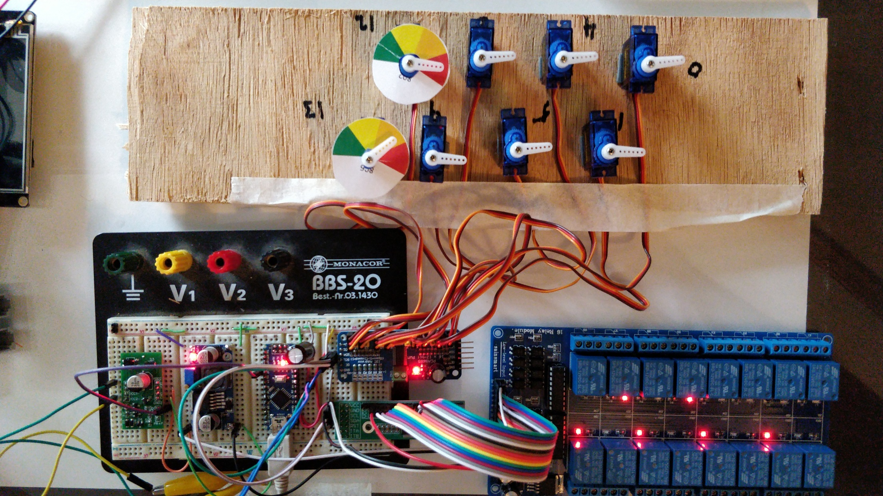
Part 3
DIY
Switch Machine
DCC Decoder

Slide 2
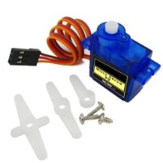
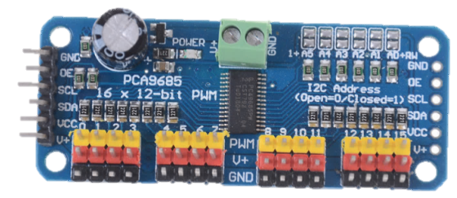
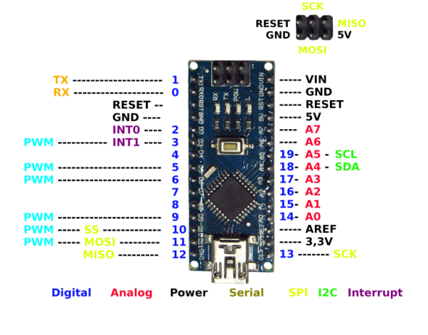
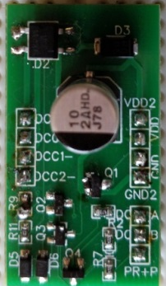
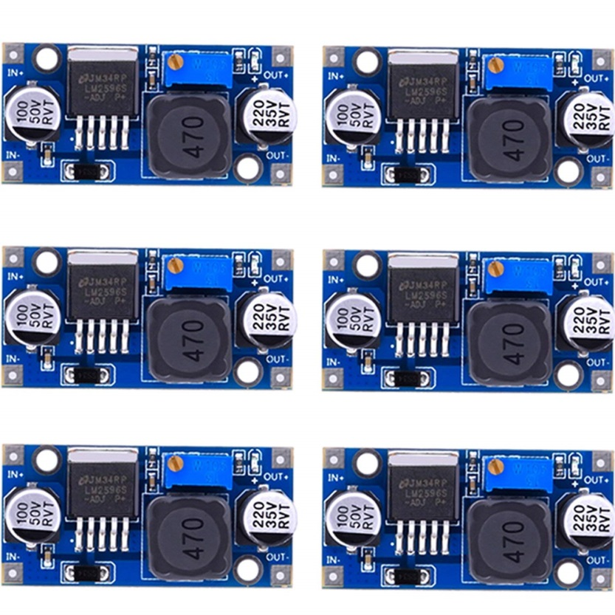
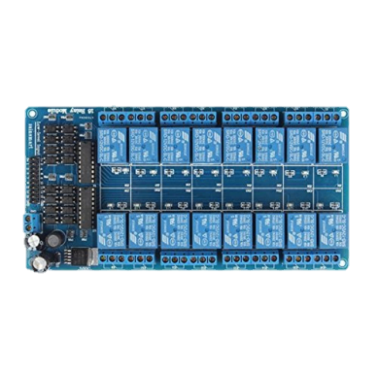
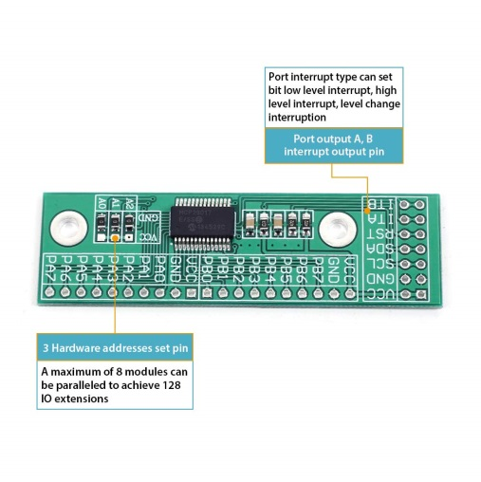
Arduino Nano Accessory Decoder
5V
Set to 7.5V
Connect up to 16 Servos SG90
3.5 - 8.4 Volts
DCC Track
PWM Driver
I2C GPIO Expander
DCC Interface
Buck Converter
Arduino Nano
Connect up to 8 Tortoises or Double Magnet Drives

Slide 3
Servo Decoder Requirements
Connects to DCC, no additional power supply
Individual Address for each Servo
Support of full Switch and Signal Address Ranges
Adjustable Rotation Angles per Servo
Adjustable Rotation Speed per Servo
✓
✓
✓
✓
✓

Slide 4
Servo Decoder Requirements Page 2
×
Supports Slow Motion Switch Machines
Supports 3 wire Solenoid Switch Machines
Supports 2 wire Solenoid Switch Machines
×
×

Slide 5
Development Steps
Analyze new requirements
Develop a concept for the hardware
Develop a concept for the software
Implement Hardware and test
Implement Software and test
Debug, improve and finalize

Slide 6
Table of Contents
Requirements Analysis: Controlling Switch machines
Building the hardware: Add 8 channels for Switch Machines
Testing the hardware
Software Development 1: Preparation
Software Development 2: Adding switch machine support
Conclusions
0:58
3:04
9:12
15:07
31:52
1:05:03

Slide 7
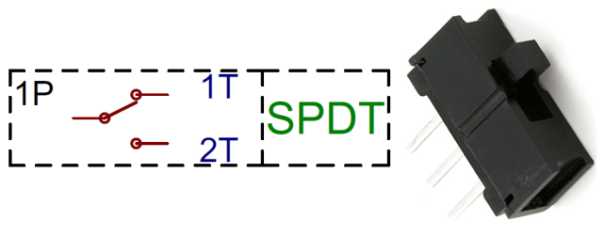



Switch Machines
Type Example How to Control
Stall Motor Circuitron Tortoise
Limit Switch Motor Aristo 11299
3 Wire Solenoid Atlas Snap Switch
2 Wire Solenoid Kato N Scale
+
-
M
+
-
Polarity change
Permanent on
+
-
M
+
-
Polarity change
Permanent on
-
-
1 of 2 coils activated
Momentary on
+
+
-
+
-
Polarity change
Momentary on
Additional information: https://dccwiki.com/Turnout_Motors

Slide 8
Hardware Design
Use Relay board with 2 relays per turnout, a total of 16 relays for 8 turnouts
Alternatively we could use H-Bridges
Use MCP23017 GPIO Port Extender to control 16 IO’s via I2C Bus

Slide 9
Software Requirements and Design
Support for Switch commands only (2 positions: CL / TH), no Signal commands (32 Aspects)
Programmable Duration of Activation
2 Step approach with Target and Timer as before
Individual Address and IO Ports
Plus: Individual Servo Speed for each direction

Slide 10
Arduino Nano Accessory Decoder
5V
Set to 7.5V
Connect up to 16 Servos SG90
3.5 - 8.4 Volts
DCC Track
PWM Driver
I2C GPIO Expander
DCC Interface
Buck Converter
Arduino Nano
Connect up to 8 Tortoises or Double Magnet Drives

Slide 11
Testing the Hardware
Install the Library Adafruit_MCP23017
Use and Improve the Toggle Example

Slide 12
Building the Bridge
Third Improvement: Preparation
Individual Rotation Speed in each direction
Configurable Port Address
Preparation for adding Relay Board
Adding a driveType Configuration Variable
Adding a Structure for type specific processing

Slide 13
Building the Bridge
Fourth Improvement: Adding Relay Support
Blocking out Signal Commands
Differences between Relay and Servo Control
On/off vs. continuous position command
Relays can be retriggered
Implementing Relay Control
Testing and Performance Review

Slide 14
Servo Decoder Requirements Page 2
Supports Slow Motion Switch Machines
Supports 3 wire Solenoid Switch Machines
Supports 2 wire Solenoid Switch Machines
✓
✓
✓

Slide 15
Additional Materials on Github: https://github.com/tanner87661/IoTT-Video19
Arduino Basics 101: https://www.youtube.com/watch?v=BtLwoNJ6klE
Arduino Basics 102: https://www.youtube.com/watch?v=YT3birSKLLU&t=398s
Arduino Basics 103: https://www.youtube.com/watch?v=EVm0qVJ56II
Arduino State Management: https://www.youtube.com/watch?v=3VZgaJBrZD8
Layout Intro Sequence Outdoor Layout: Beat Deola, Switzerland​
DCC Interface: If interested, send me a PM. I have some of the prototypes available for cost plus shipping.
Buck converter: https://www.amazon.com/MCIGICM-step-down-Converter-3-0-40V-1-5-35V/dp/B06XZ1DKF2/ref=sr_1_5?keywords=buck+converter&qid=1554521368&s=gateway&sr=8-5
Arduino Nano: https://www.amazon.com/gp/product/B01N7I0W77/ref=ppx_yo_dt_b_asin_image_o00_s00?ie=UTF8&psc=1
PWM driver: https://www.amazon.com/Onyehn-Channel-PCA9685-Arduino-Raspberry/dp/B07GJCPWW2/ref=pd_day0_hl_147_2/144-9269444-7135168?_encoding=UTF8&pd_rd_i=B07GJCPWW2&pd_rd_r=7c0128c8-581c-11e9-8362-b1c2d0dccc11&pd_rd_w=ebl7B&pd_rd_wg=XDjih&pf_rd_p=ad07871c-e646-4161-82c7-5ed0d4c85b07&pf_rd_r=MFZXEC12T0FFV415AHQ4&psc=1&refRID=MFZXEC12T0FFV415AHQ4
Micro Servos: https://www.amazon.com/Micro-Helicopter-Airplane-Remote-Control/dp/B072V529YD/ref=pd_bxgy_60_img_2/144-9269444-7135168?_encoding=UTF8&pd_rd_i=B072V529YD&pd_rd_r=86eda38f-581c-11e9-9502-091092cc734e&pd_rd_w=OfHyY&pd_rd_wg=VPeRR&pf_rd_p=a2006322-0bc0-4db9-a08e-d168c18ce6f0&pf_rd_r=PTY6VGCE68SEB9VVHH2E&psc=1&refRID=PTY6VGCE68SEB9VVHH2E
16 Channel Relay Board: https://www.amazon.com/gp/product/B0057OC66U/ref=ppx_yo_dt_b_asin_title_o01_s00?ie=UTF8&psc=1
16 bit GPIO Expander: https://www.amazon.com/gp/product/B07GRQWQF9/ref=ppx_yo_dt_b_asin_title_o01_s00?ie=UTF8&psc=1
Turnout Motors: https://dccwiki.com/Turnout_Motors

